Slide 1
Counting, Radix, Bucket sort
Chaklam Silpasuwanchai

Slide 2
Readings
Chapter 8, Sorting in Linear Time, Cormen et al. (2009). Introduction to Algorithms, Third Edition (3rd ed.). The MIT Press

Slide 3
Comparison sorting
Insertion sort, merge sort, heap sort, and quicksort are all comparison sorts
In worst case, any comparison algorithm requires at least or 𝝮(n lg n)
We shall prove this using a decision model

Slide 4
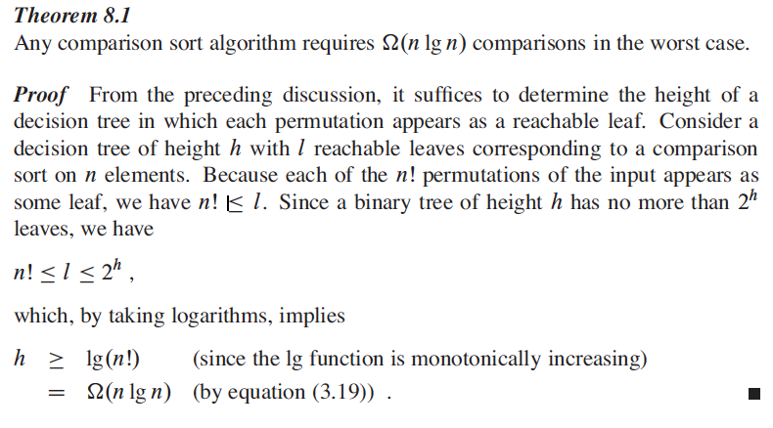
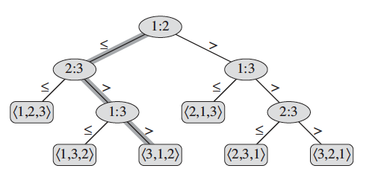
Comparison sorting
We can prove this by using viewing comparison sorts abstractly as decision trees
There are 3! = 6 possible permutations, thus there should be 6 leaves

Slide 5
Comparison sorting
Here, we gonna introduce counting sort, radix sort and bucket sort - that run in linear time
Since they are not comparison sort, the 𝝮(n lg n) does not apply to them
Nevertheless, in order for them to run linearly, they make some sacrificial assumptions

Slide 6
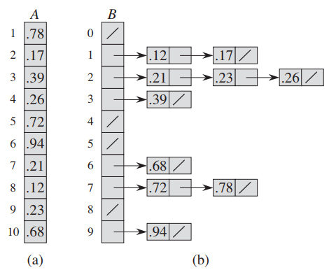
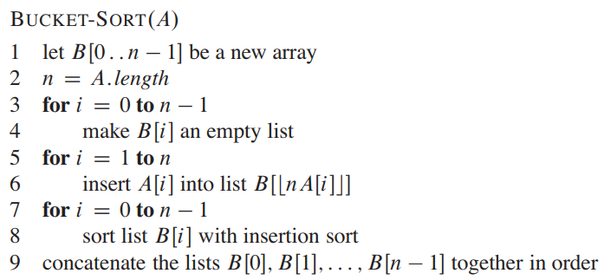
Bucket sort
Bucket sort assumes that input is from a uniform distribution and has an average-case running time of O(n)
Like counting sort, bucket sort assumes that the input is generated by a random process which yields element that are uniform and independent
Bucket sort divides the interval [0, 1) into n equal-sized subintervals, or buckets, and then distribute the n input numbers into the buckets
Bucket sort code assumes that the input is an n-element array A, and that each element A[i] in the array satisfies 0 ≤ A[i] < 1. The code also assumes a temporary array B[0….n-1] of linked lists for the buckets
How much time? →all lines except line 8 takes O(n), thus we need to analyze how much time taken by n calls to insertion sort.
Vs. quicksort? → If you have bad distribution, bucket sort will do huge amount of extra work. Bucket sort also requires temporary storage so bad for big data.
Code above: Assumes that each element in n-element array has d digits, where digit 1 the lowest order digit and d is the highest-order digit

Slide 7
Exercise
CLRS 8.4-1 Illustrate BUCKET-SORT on array A: <.79, .13, .16, .64, .39, .20, .89, .53, .71, .42>

Slide 8
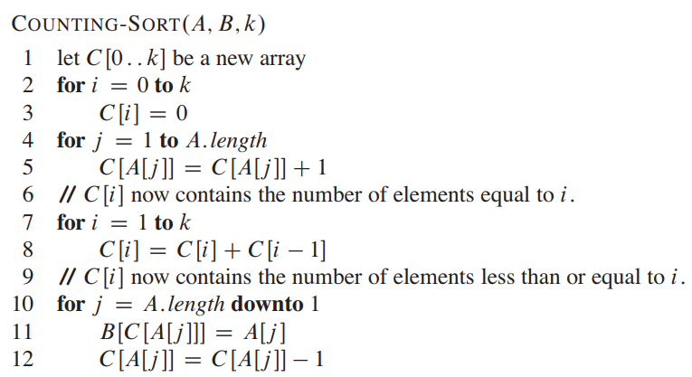
Counting sort

Slide 9
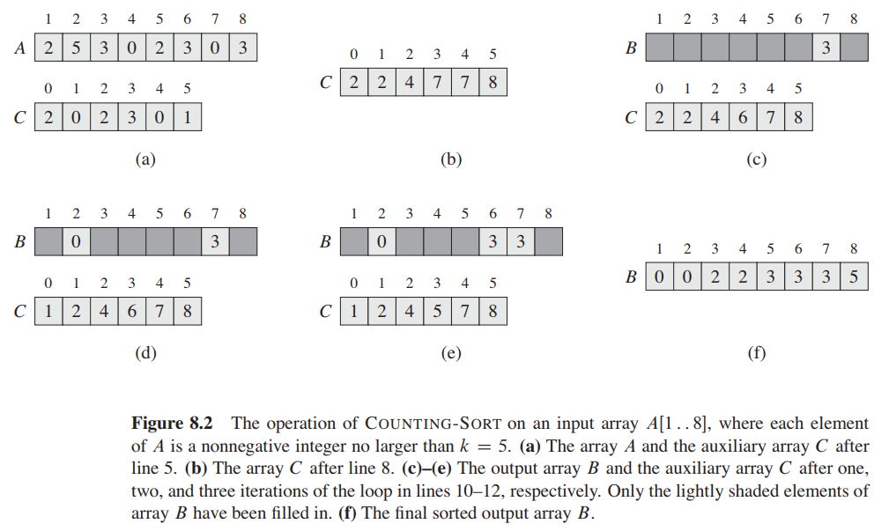
Counting sort
Assumes that each of the n input elements is an integer in the range of 0 to k. When k = O(n), the sort runs in Θ(n) time
Counting determine for each element x, the number of elements less than x
How much time does counting sort require? → For loops of line 2-3 takes Θ(k), for loops 4-5 takes time Θ(n), for loops 7-8 takes Θ(k), and for loop 10-12 takes time Θ(n). Thus overall time is Θ(n + k). We usually use counting sort when K = O(n), thus the running time is Θ(n)
Counting sort is stable
Often use as subroutine in radix sort

Slide 10
Exercise
CLRS 8.2-1 Illustrate COUNTING-SORT on array
A = <6, 0, 2, 0, 1, 3, 4, 6, 1, 3, 2>

Slide 11
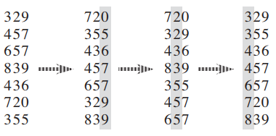
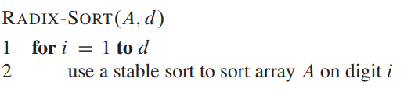
Radix sort
Radix sort is sorting based on sorting the digit, from least significant digit first
For radix sort to work, obviously, the digit sorts must be stable
Sometime, we might wish to sort dates by three keys using stable sort, that s, first on day, then on month, and finally on year. This kind of sorting only works when the sorting is stable (e.g., counting sort)
Is radix sort preferable to a comparison sorting algorithm? → To be precise, radix sort takes O(d * n), while quicksort takes O(n lg n). Assume 16 numbers to be sorted, with 5 digits each
Radix sort = 16 * 5 = 80 times units
Quick sort = 16 * 4 = 64 time units
Thus, if d is large, quicksort wins
Quicksort sorts in place, while counting sort uses temporary storage. Thus when memorage storage is at concern, we prefer in-place algorithm
Counting sort does not work with negative numbers
Code above: Assumes that each element in n-element array has d digits, where digit 1 the lowest order digit and d is the highest-order digit

Slide 12
Exercise
CLRS 8.3-1 Illustrate RADIX-SORT on: COW, DOG, SEA, RUG, ROW, MOB, BOX, TAB, BAR, EAR, TAR, DIG, BIG, TEA, NOW, FOX

Slide 13
Assignment
Implement bucket and radix sort, and compare with quicksort

